Slide 1
Scikit learn

Slide 2
What is scikit learn?

Slide 3
Simple and efficient tool for data mining and data analysis.
Built on numpy , scipy and matplotlib.

Slide 4
What What we achieve by using it?

Slide 5
Regression
Classification
Regression
d
P
Predicting a continuous quantity
ex.price
Predicting a discrete quantity
ex. mail :spam or not spam
I
xxx

Slide 6
Regression
Clustering
Model selection
Liberation Sans
d
P
Comparing , Validating and choosing parameters and models
Automatic grouping of similar objects in to sets
I
xxx

Slide 7
Regression
Dimensionality
reduction
Pre-processing
Liberation Sans
d
P
Features extraction and normalization
Reducing the number of random variables
I
xxx

Slide 8
Linear Regression

Slide 9
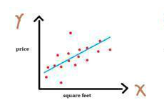
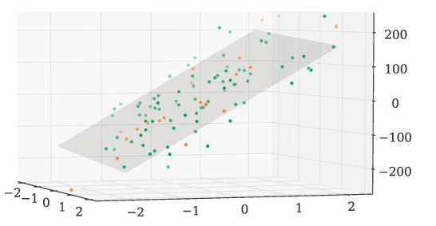
a model that assumes a linear relationship between the independent input variables (x) and the single dependent output variable (y) .
When there is a single input variable (x), the method is referred to as simple linear regression , and relation is a line.
When there are multiple input variables, the method is known as multiple linear regression, and relation is a plane.

Slide 10
Linear regression using scikit learn

Slide 11
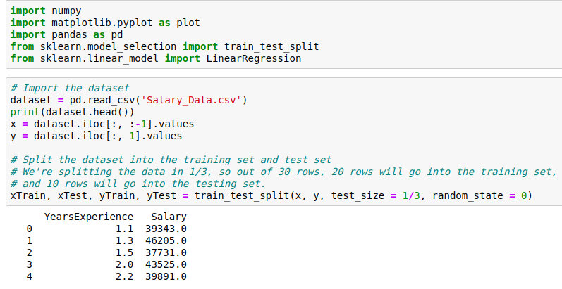

Slide 12
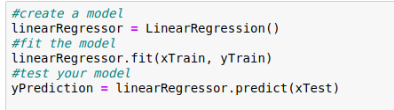
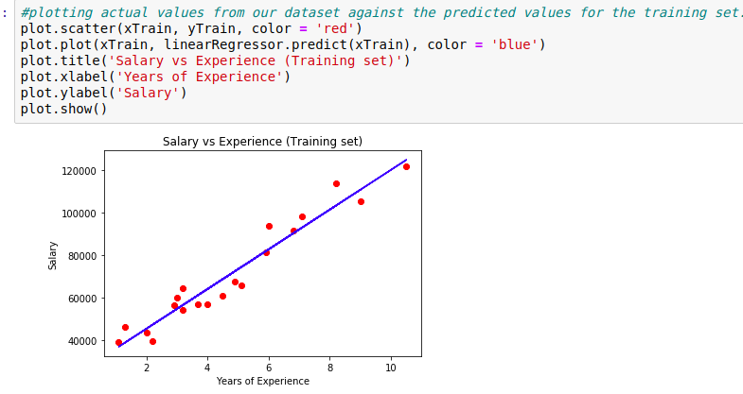

Slide 13
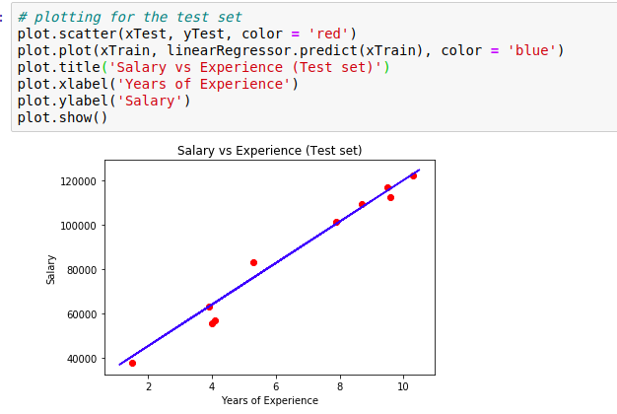

Slide 14
Logistic Regression

Slide 15
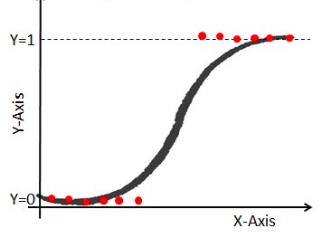
Method used to predict dependent categorical output based on independent input.
→ Categorical : means to take binary values like
(0,1) – (yes,No) .
So , output represents a probability
One of the most popular techniques to solve a classification problem

Slide 16
Logistic regression using scikit learn

Slide 17

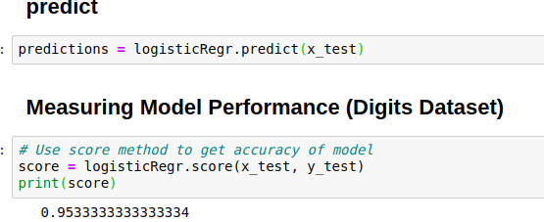

Slide 18
K-means clustering

Slide 19
one of the most widely used unsupervised machine learning algorithms that forms clusters of data based on the similarity between data instances.
The K in the K-means refers to the number of clusters that should be pre-defined.

Slide 20
K-means clustering with scikit_learn

Slide 21

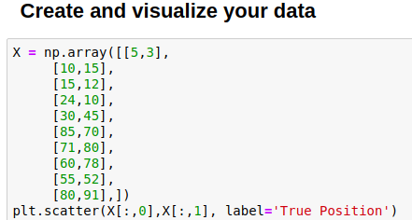
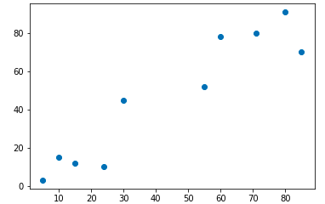

Slide 22
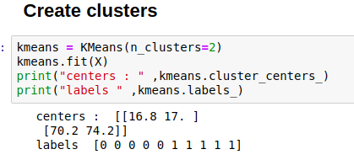
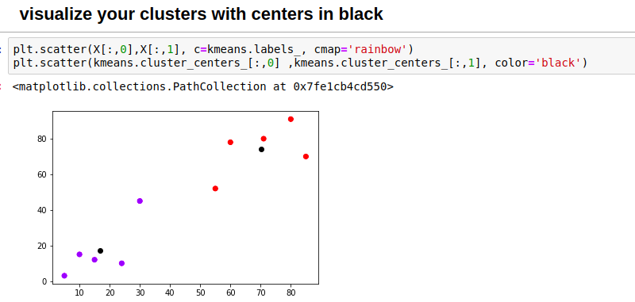

Slide 23
Thank you

